Slide 1
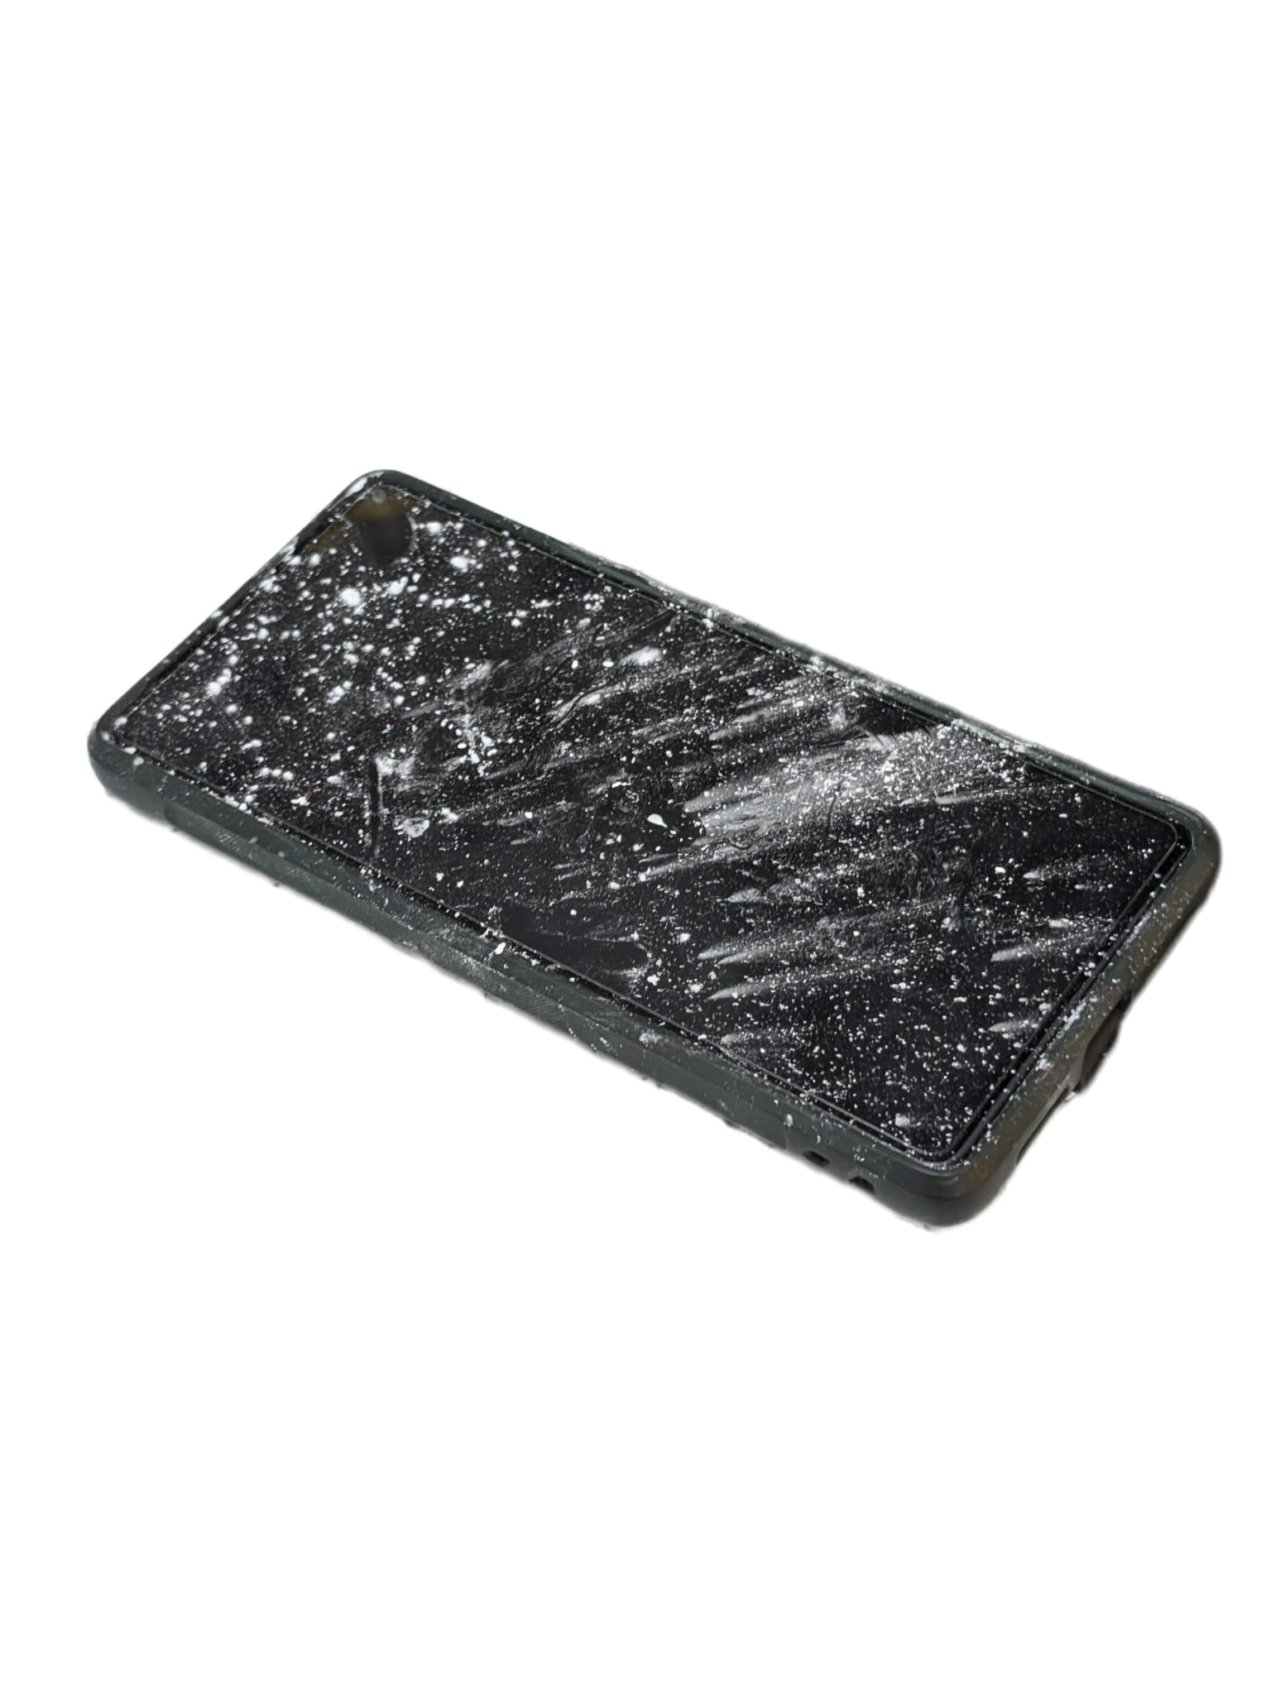
Hands-Free
Recipe Assistant
UAT AI HACKATHON · COMPUTER VISION
No more mess, with easy tech
Isabela Teck October 11, 2026
Notes:
Hi everyone, I'm [your name]. I built a recipe assistant you control with hand gestures, using computer vision. Four minutes: the problem, how it works, a live demo, and how AI helped me build it.

Slide 2
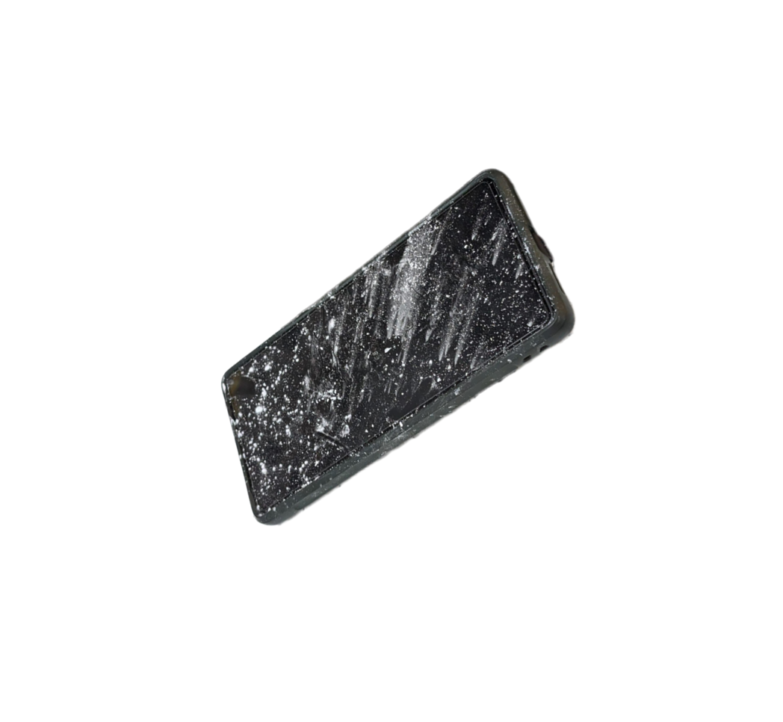
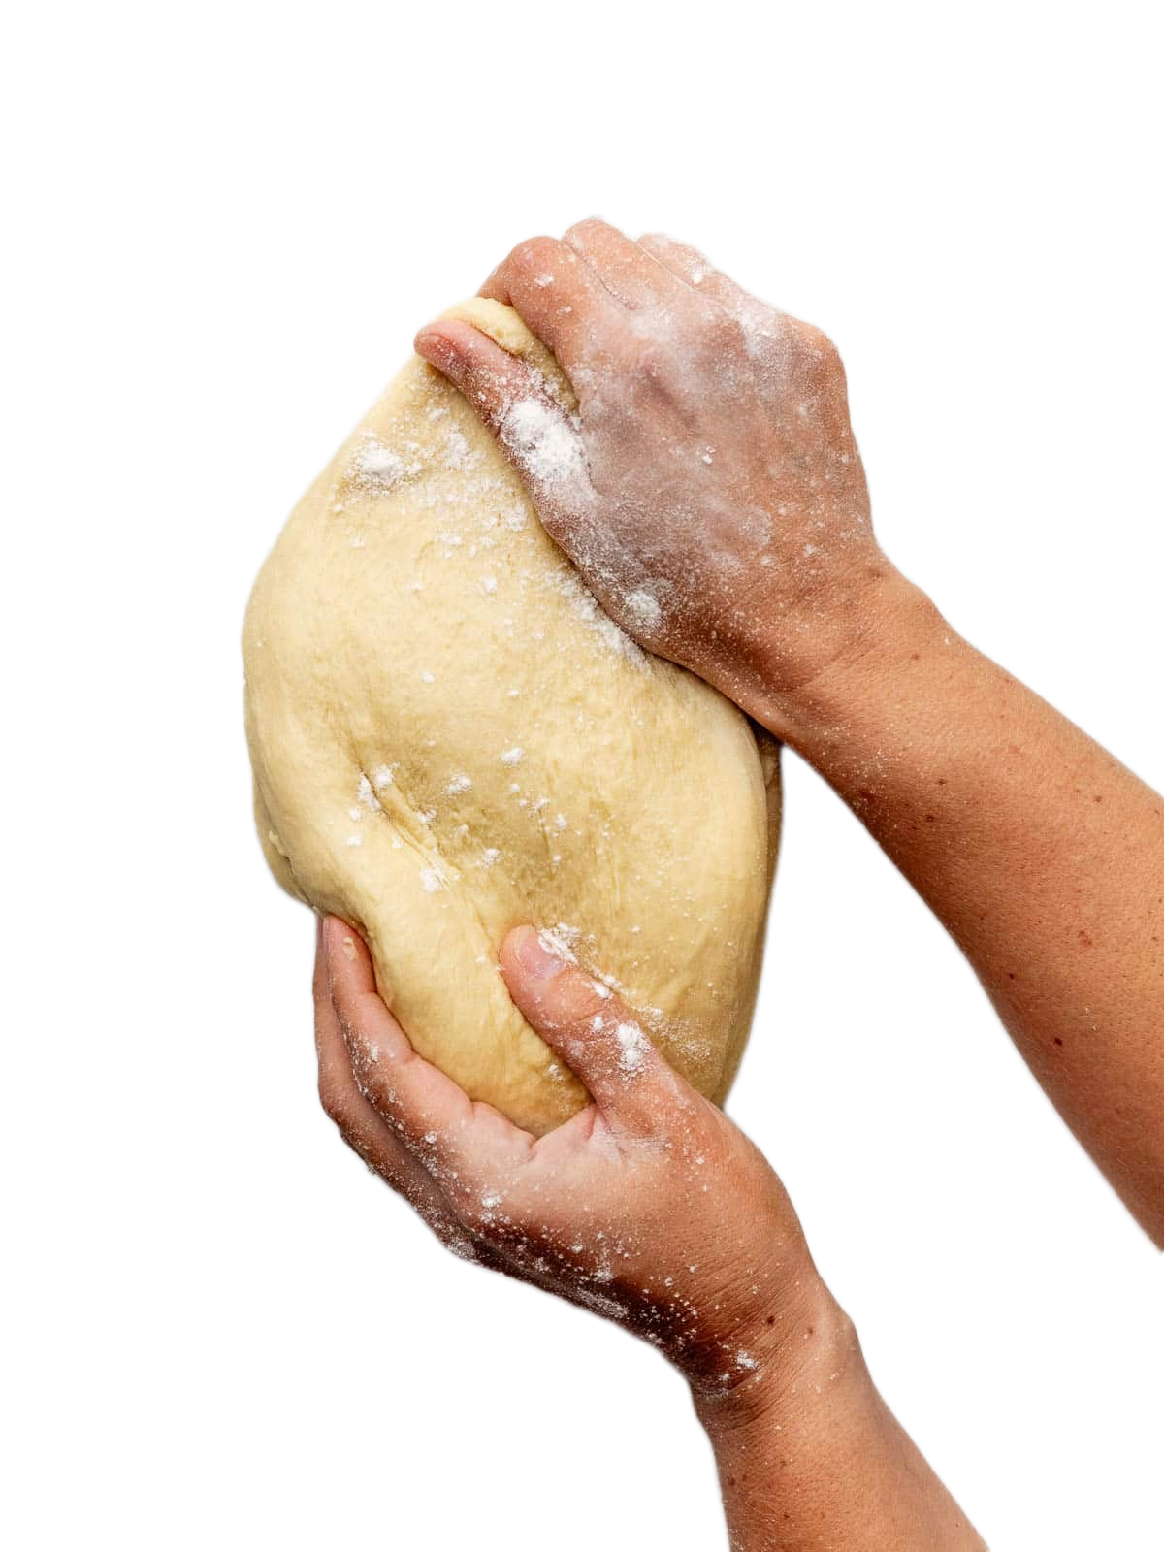
Cooking leaves your hands busy and sometime messy
THE PROBLEM
Sticky hands
Dirty screens
Lost place
Dough, sauces, flour, oils and sticky intergradient.
With dirty screen on device can be hard to clean and hard the device
You scroll back and forth to find the right step.
Notes:
Everyone who cooks has touched a phone with dough on their fingers. The target user is the home cook, and especially beginners following a recipe step by step.

Slide 3
With video or web camera, we can make recipe be less a mess with reading it out loud to you
OUR SOLUTION
The theme: computer vision
The result
Computers that understand images. Here the camera finds your hand and face, then reads your gesture.
No touching. The app reads each step aloud, shows it on screen, and runs timers.
Notes:
Computer vision means teaching a computer to understand what a camera sees. My app uses the laptop webcam to find a hand, recognize the gesture, and move through the recipe without touching anything.

Slide 4

From camera to kitchen in four steps
HOW IT WORKS
4 · Respond
1 · See
2 · Understand
3 · Decide
Voice and LCD
Webcam
MediaPipe
Python app
OpenCV grabs live video
Hand gestures and face direction
Next, back, repeat, timer
Reads aloud, Arduino shows steps
Notes:
The webcam feeds OpenCV. MediaPipe finds the hand and classifies the gesture, and a second model checks where my face is pointing. My Python app decides what to do, then speaks the step and sends it over USB to an Arduino with an LCD and buzzer. Everything is free and runs on my laptop.

Slide 5
Six simple hand signals
THE GESTURES
Thumb up
Thumb down
Open palm
Next step
Previous step
Repeat the step
Point up
Fist
Swipe
Start the timer
Cancel the timer
Right is next, left is back
Notes:
Five poses recognized by MediaPipe's gesture model, plus a swipe I built myself by tracking how fast the palm moves sideways. A short hold time stops accidental triggers.

Slide 6
Look at the camera to swipe
SAFETY PROTOCOL
Why
How
Reaching across the counter or waving at a family member should never change your recipe.
A second computer vision model tracks which way your face points. A swipe only counts while you look at the screen.
Safety Features: Face must be facing or looking at the camera for it perform
Notes:
This is the safety feature. The face landmark model measures head yaw and pitch. If I'm not facing the camera, swipes are ignored and the screen warns me.

Slide 7
A real kitchen display, built for $0
ROBOTICS TIE-IN
Arduino Uno + LCD
Buzzer
USB serial link
Shows the step number, ingredients and a live timer countdown.
Chirps on every gesture and sounds a 3-beep alarm when time is up.
Python sends short commands. The Arduino acts on them.
Notes:
As a robotics and AI major, I wanted the vision system to drive real hardware. Parts from my Arduino kit: an LCD1602, a buzzer, and a potentiometer. No money spent.

Slide 8
Let's cook.
LIVE DEMO
Thumbs up, swipe, point for a timer. If the live demo fails, the demo video is the backup.
Notes:
Switch to the app now. Run: python recipe_final_v4.py recipe_demo.json. Show: ingredients screen, thumbs up to next, a swipe while looking at the camera, a swipe while looking away (warning), the timer, and the LCD. Backup: play the demo video.

Slide 9
Who built what
AI DISCLOSURE AND CREDITS
Part | Source
Idea, recipe and hardware | Isabela Teck, Design the Arduino device and my recipe
Code | Claude (Anthropic)debugged and wrote some of the code Isabela wrote some of the code GitHub CoPilot help write some of the code and debugged
Gesture and face models | Google MediaPipe, open source
Libraries | OpenCV, pyserial, pywin32, Arduino LiquidCrystal
Full credits and setup steps are in the README on GitHub
Notes:
Be upfront: I used Claude as a tutor and coding assistant. I typed the code myself, tested it on my own laptop, and debugged it. MediaPipe by Google provides the pretrained hand and face models. Everything else is open source. Edit this table if you used any other AI tools.

Slide 10
Questions?
THANK YOU
Code and README: https://github.com/Isabela5301/hands-free-recipe_assistant
Demo Youtube Link: youtube.com/watch?v=AqSJ-2K7KCY&feature=youtu.be
Notes:
Thank you. Happy to answer questions about the gestures, the safety check, or the Arduino setup. The repo link is on screen.

